Slide 1

Twitter Sentiment Analysis: Insights from 1.6 Million Tweets
SRM INSTITUTE OF SCIENCE AND TECHNOLOGY
SCHOOL OF COMPUTING
DEPARTMENT OF COMPUTING TECHNOLOGIES
18CSP107L / 18CSP108L - MINOR PROJECT / INTERNSHIP
Batch ID:
Student 1 Reg. No: RA2011003010370
Student 1 Name: Ali Hassan
Student 2 Reg. No: RA2011003010395
Student 2 Name: Nitin Shukla
Guide name: Dr.Eliazer M.
Designation: Assistant Professor Department: C.Tech.

Slide 2
Twitter Sentiment Analysis: Insights from 1.6 Million Tweets
Abstract:
The generation of millions of tweets every day has made tweets an important source for understanding opinions of a specific group of people. By using different machine learning algorithms, sentiment analysis serves this purpose. In this project, a sentiment analysis was applied to a large dataset that consists of 1,600,000 tweets extracted using Twitter API. We applied pre-processing, descriptive and predictive analysis to the data. The tweets are classified using 6 models generated from several widely used machine learning algorithms such as LSTM, CNN and Naive Bayes. The best performing model for the dataset is determined after the mentioned analyses are completed.
Keywords - sentiment analysis, NLTK, embedding, corpus

Slide 3
Twitter Sentiment Analysis: Insights from 1.6 Million Tweets
Introduction:
Sentiment analysis, a sub-field within the realm of Natural Language Processing (NLP), stands as a prominent and extensively researched topic in the domain of data science. Our project is focused on conducting sentiment analysis specifically within the context of social media. Our primary goal is to develop the capability to categorize tweets, reviews, and comments posted on social media platforms as either positive, negative, or neutral in sentiment.
A pivotal aspect of our project revolves around the task of data collection, wherein we gather a substantial volume of data from various sources. During our search for suitable datasets, we encountered several open-source options, including Sentiment140 [1] among others. After a thorough evaluation, we opted to utilize the Sentiment140 dataset.
It's worth noting that many of the open-source datasets we considered were already well-structured and came with proper labeling. In contrast, data collected directly by us necessitates meticulous labeling efforts. Following data acquisition, our workflow involves essential stages such as data cleaning, preprocessing, and the division of data into distinct training and testing sets.
To facilitate our project, we explored various tools and frameworks available for NLP tasks. Among the options, we identified the Natural Language Toolkit (NLTK) [2] as a powerful and widely-used open-source Python library. NLTK provides a comprehensive set of tools and resources essential for initiating sentiment analysis endeavors.

Slide 4
Twitter Sentiment Analysis: Insights from 1.6 Million Tweets
Existing System:
The existing techniques and methods for sentiment analysis in health crises like COVID-19 typically include:
TextBlob and NLTK: Python libraries for basic sentiment analysis.
VADER Sentiment Analysis: A lexicon and rule-based tool suitable for social media text.
Machine Learning Algorithms: SVM, Random Forest, and Deep Learning models.
Topic Modeling: LDA, NMF for extracting relevant topics.
Rule-Based Approaches: Custom rules to identify sentiment indicators.
Data Preprocessing: Text cleaning, stop-word removal, etc.
Data Collection: Web scraping, APIs for data retrieval.
NLP Tools: spaCy, Gensim, Word2Vec for advanced text analysis.
Sentiment Lexicons: Dictionaries of sentiment-laden words.

Slide 5
How is our project better than existing system
Extended Timeframe and Data Set: Our project covers a broader timeline, including later pandemic stages, providing a continuous view of sentiment evolution.
Advanced Analysis: It employs advanced sentiment analysis techniques, including machine learning and real-time analysis.
Diverse Data Sources: Our project expands beyond Twitter, offering insights from multiple social media platforms.
Misinformation Control: It actively combats misinformation, ensuring more reliable insights.
Policy Recommendations: Our project offers actionable policy insights based on sentiment analysis.
User-Friendly Interface: It includes user-friendly dashboards and visualization tools for easier data interpretation.
Continuous Updates: Your project adapts to evolving sentiment and crises over time, ensuring long-term relevance.

Slide 6
Problem statement and Objectives:
In today's digital age, social media platforms generate an enormous amount of text data, including tweets, reviews, and comments. Understanding the sentiment behind this data is crucial for businesses, organizations, and researchers to gain insights into public opinions and attitudes. However, analyzing such vast amounts of text data manually is impractical. Therefore, the problem we aim to address in this project is how to automatically classify social media content into positive, negative, or neutral sentiments using machine learning and natural language processing techniques.

Slide 7
Objectives:
Data Collection and Preparation:
Collect a large dataset of social media text, specifically tweets, using Twitter API.
Preprocess the data to remove irrelevant information and ensure it is suitable for analysis.
Exploratory Data Analysis (EDA):
Analyze the dataset to understand the characteristics of the text data, including letter and word frequencies.
Investigate the distribution of positive and negative sentiment instances.
Text Feature Extraction:
Apply various text feature extraction methods, such as Bag-of-Words and TF-IDF, to represent the text data in a format suitable for machine learning.
Model Selection and Training:
Experiment with different machine learning algorithms, including LSTM, CNN, and Naive Bayes, to determine the best-performing model.
Train and fine-tune the selected models using the prepared dataset.
Evaluation Metrics:
Evaluate the models' performance using relevant metrics, including precision, recall, F1-score, accuracy, and AUC-ROC.
Compare the performance of different models to identify the most effective one.
Visualization:
Create visualizations to represent the results, such as ROC curves, confusion matrices, and word clouds for sentiment analysis.
Interpretation and Insights:
Interpret the results to gain insights into the sentiment of the social media data.
Understand which words or phrases are indicative of positive, negative, or neutral sentiment.

Slide 8
Twitter Sentiment Analysis: Insights from 1.6 Million Tweets
Proposed System:
Data Collection and Cleaning: Collect tweets using Twitter API, clean and structure the data.
Exploratory Data Analysis (EDA): Analyze data to understand letter/word frequencies and sentiment distribution.
Text Feature Extraction: Convert text into numerical features using techniques like Bag-of-Words and TF-IDF.
Model Selection and Training: Experiment with LSTM, CNN, and Naive Bayes models, fine-tune, and train them.
Evaluation Metrics: Assess models using precision, recall, F1-score, accuracy, and AUC-ROC.
Visualizations: Display ROC curves, confusion matrices, and word clouds to visualize results.
Interpretation: Extract insights, identify key words/phrases indicating sentiment.

Slide 9
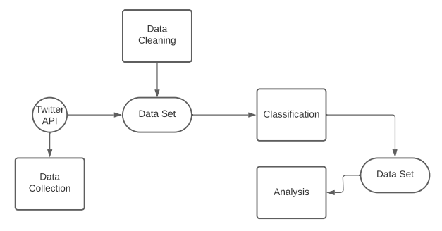
Architecture/Block Diagram of the proposed model

Slide 10
Architecture/Block Diagram of the proposed model
1. Data Collection:
Gather 1,600,000 tweets from various sources, including Twitter API and open-source datasets.
2. Data Preprocessing:
Clean and preprocess data:
Remove unnecessary fields.
Handle missing values.
Text preprocessing (tokenization, stopword removal, etc.).
3. Data Analysis:
Explore data for insights:
Analyze letter and word frequencies.
Examine common words.
Assess data entropy and correlations.
4. Embedding:
Utilize GloVe for word embedding.
5. Modeling:
Implement machine learning models:
LSTM Models
CNN Models
Naive Bayes Models
6. Training:
Train multiple models with different configurations.
7. Evaluation Metrics:
Assess model performance using accuracy, precision, recall, F1-score, AUC, and ROC curves.
8. Results Analysis:
Compare model performances.
Identify the best-performing model.

Slide 11
Modules Description:
Module 1: Data Collection
Objective: Gather a large dataset of 1,600,000 tweets from various sources, including Twitter API and open-source datasets.
Functions:
Collect tweets based on specific criteria (e.g., keywords, hashtags).
Extract relevant data fields (e.g., text, timestamp, user).

Slide 12
Module 2: Data Preprocessing Objective: Prepare the raw data for analysis and modeling by cleaning and structuring it appropriately. Functions: Remove unnecessary fields (e.g., target, id, date, query, user). Handle missing values and empty rows. Apply text preprocessing techniques (e.g., tokenization, stopword removal, lowercasing). Perform feature extraction (e.g., bag-of-words, TF-IDF). Label data for sentiment classification (positive, negative, neutral). Module 3: Data Analysis Objective: Explore the dataset to gain insights into letter and word frequencies, common words, and data entropy. Functions: Analyze letter and word frequencies. Identify the most common words in positive and negative tweets. Assess data entropy to understand the data's information content. Examine word correlations and create scatter plots.

Slide 13
Module 4: Word Embedding
Objective: Convert words into numerical representations using GloVe word embeddings.
Functions:
Initialize an embedding index with pre-trained GloVe vectors.
Map words to their vector representations for machine learning models.
Module 5: Modeling
Objective: Implement machine learning models for sentiment analysis, including LSTM models, CNN models, and Naive Bayes models.
Functions:
Develop LSTM models to capture semantic dependencies.
Create CNN models to analyze close semantic relations in text.
Utilize Naive Bayes models based on Bayes' Theorem.
Module 6: Training
Objective: Train multiple sentiment analysis models with different configurations to learn from the preprocessed data.
Functions:
Configure model hyperparameters (e.g., batch size, architecture).
Train models on the preprocessed and embedded data.
Monitor model training progress.
Module 7: Evaluation Metrics
Objective: Assess the performance of trained models using various evaluation metrics, such as accuracy, precision, recall, F1-score, AUC, and ROC curves.
Functions:
Calculate accuracy and other classification metrics.
Generate ROC curves to visualize model performance.
Evaluate model performance on test data.

Slide 14
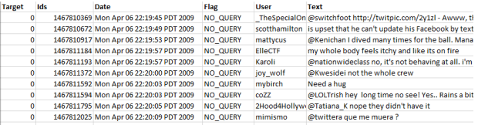
Intermediate Results and Discussion:
Dataset:
Prepared Twitter.csv
This dataset contains 1,600,000 tweets extracted using the twitter api. The tweets
have been classified from 0 (negative) to 4 (positive). The dataset contains 6 fields
which are target as integer, ids as integer, date as date, flag as string, user as string
and text as string.These 6 fields are shown below.
● target: The polarity of the tweet (0 - negative, 2 - neutral, 4 - positive)
● ids: The id of the tweet.
● date: The date of the tweet.
● flag: The query. If there is no query, then this value is NO_QUERY.
● user: The user that tweeted.
● text: The text of the tweet
A sample from the dataset

Slide 15
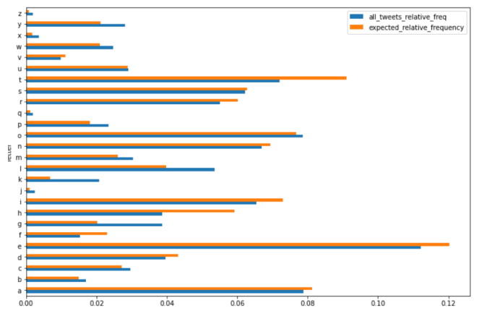
Exploring Our Data in terms of Letter Frequency
We counted the number of characters for each tweet and analyzed the data frame according to maximum number of characters, minimum number of characters, mean of the number of characters column and its standard deviation. Our longest tweet is 189 characters long, the shortest tweet is 1 character long and mean of all tweets’ character length 42.78.
The standard deviation of all tweet character length is 24.16

Slide 16
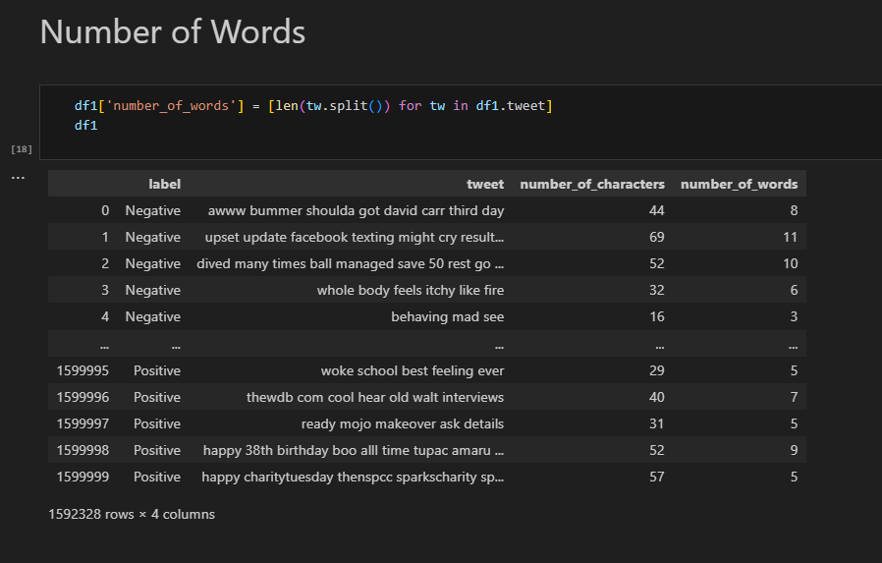
Intermediate Results:

Slide 17
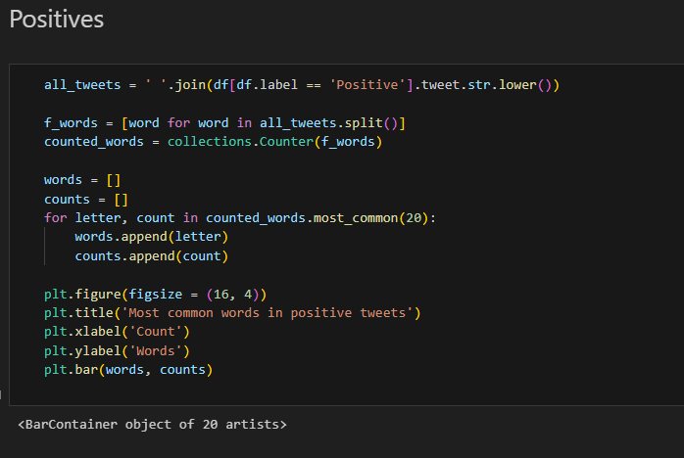
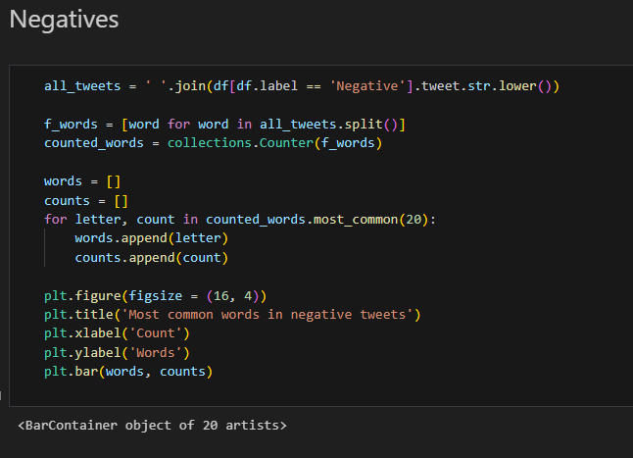
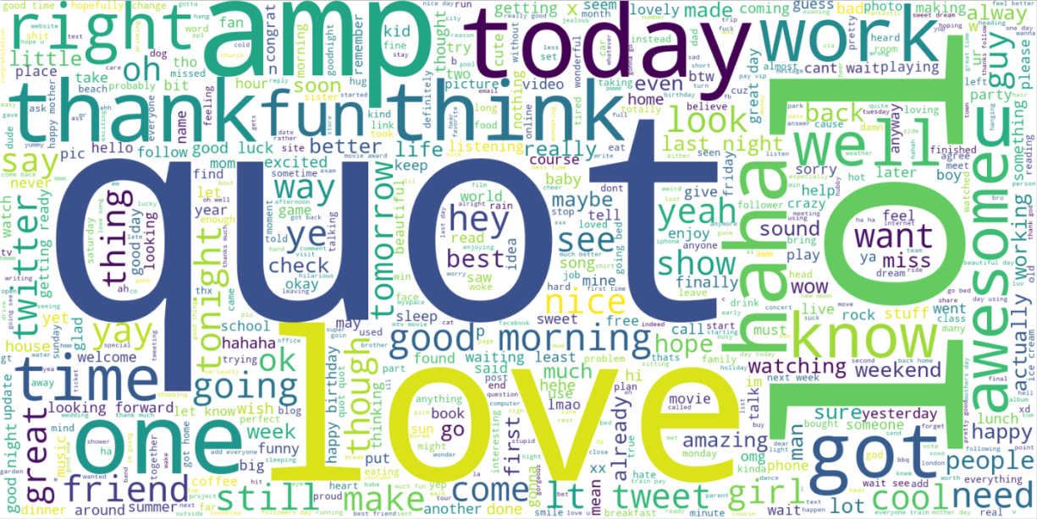
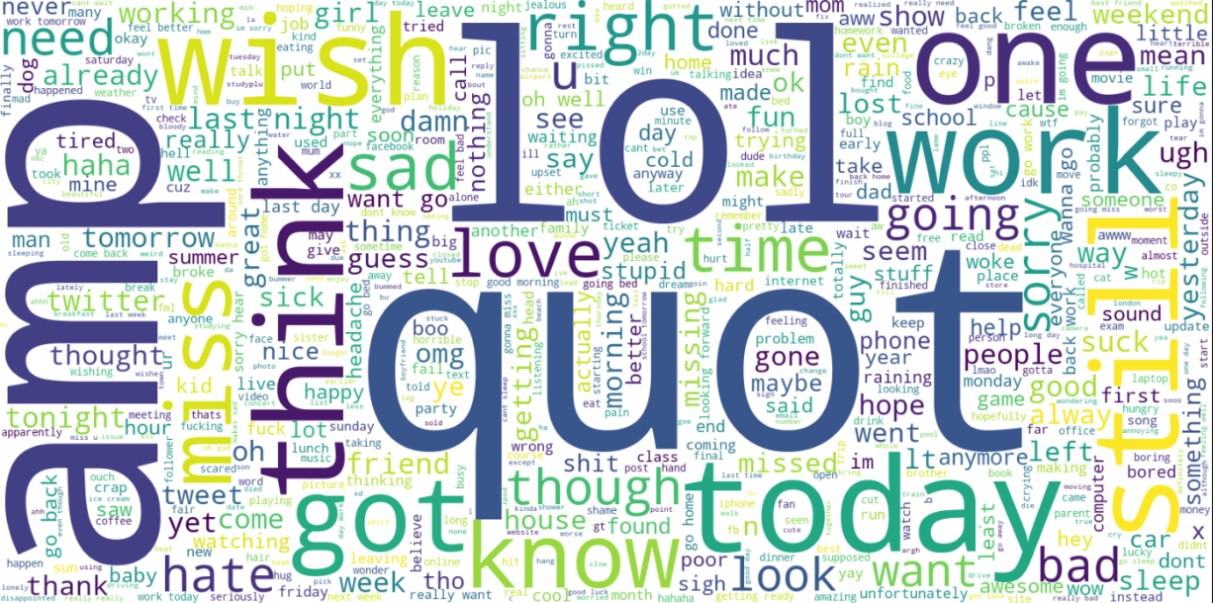

Slide 18
References:
[1] COVIDSenti: A Large-Scale Benchmark Twitter Data Set for COVID-19 Sentiment Analysis
[2] Sentiment140, http://help.sentiment140.com/home
[3] GloVe: Global Vectors for Word Representation, Jeffrey Pennington, Richard Socher, Christopher D. Manning
[4] Natural Language Toolkit, https://www.nltk.org

Slide 19
Questions?

